Slide 1
Water probe and Rainfall sensor Update
Keith Matthews

Slide 2
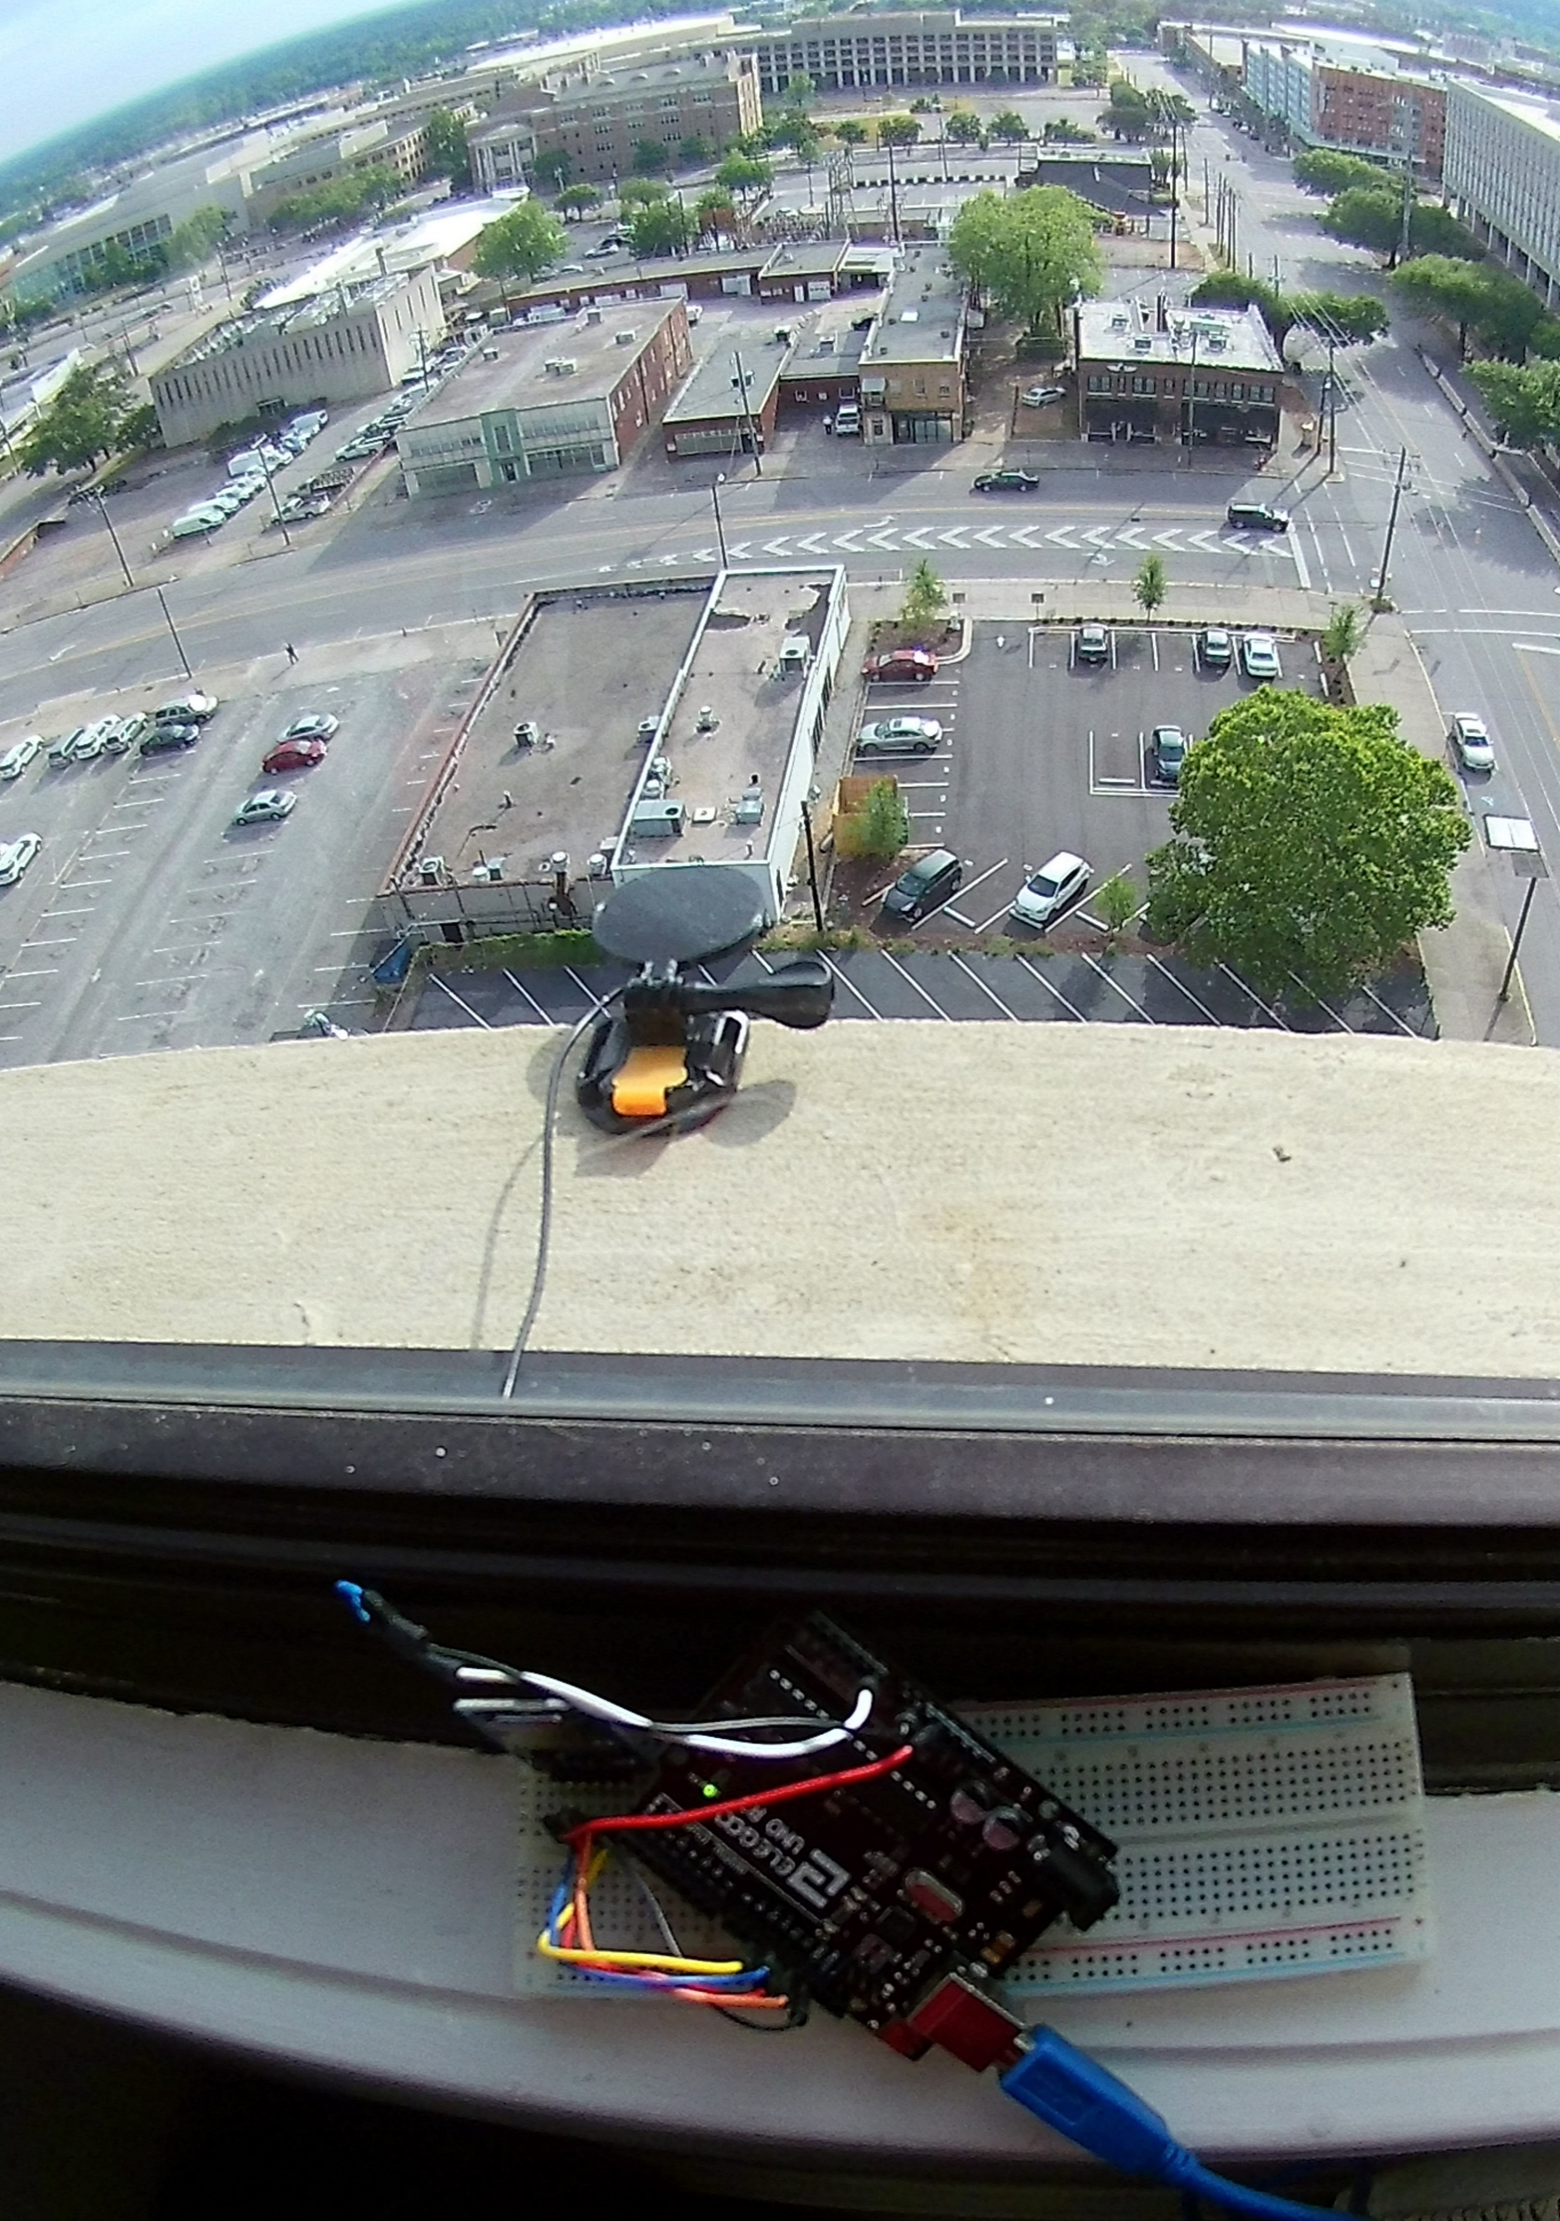
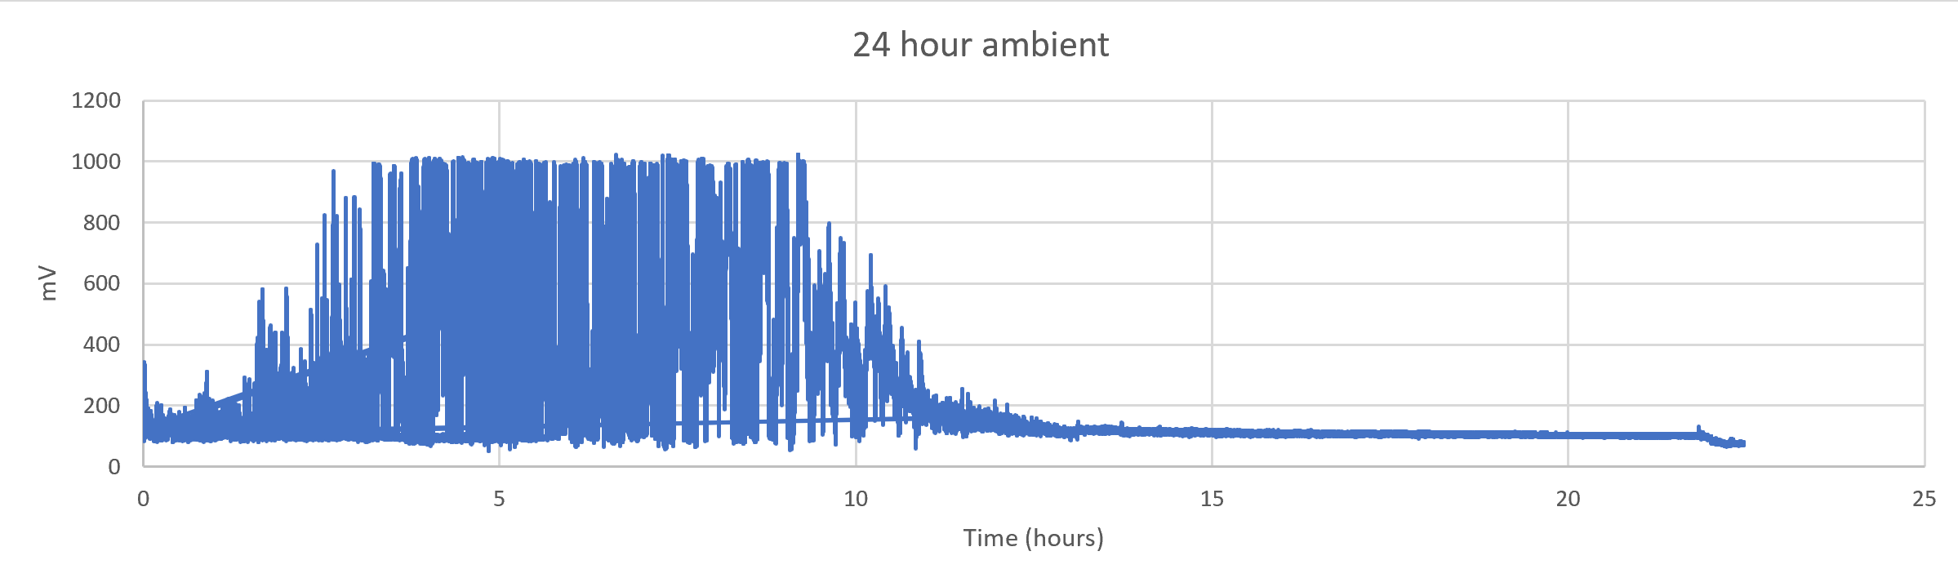
Rainfall sensor
Case
Electronics
Issues
  Vibrations
  Increased variance during the day
  Out of range

Slide 3
Piezoelectric Rainfall sensor
Conversion Factor
Piezo: measurement mV
  Deflection- caused by Force
Need “Velocity” – inches per hour
Mathematical(ish)
  Voltage = Energy per electrical charge ~ Energy (constant amperes)
  Voltage ~ K.E. = (assume terminal velocity)
  Velocity
Statistically
  Linear Regression:

Slide 4
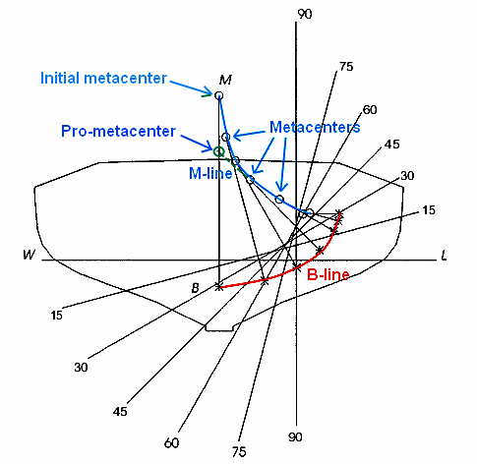
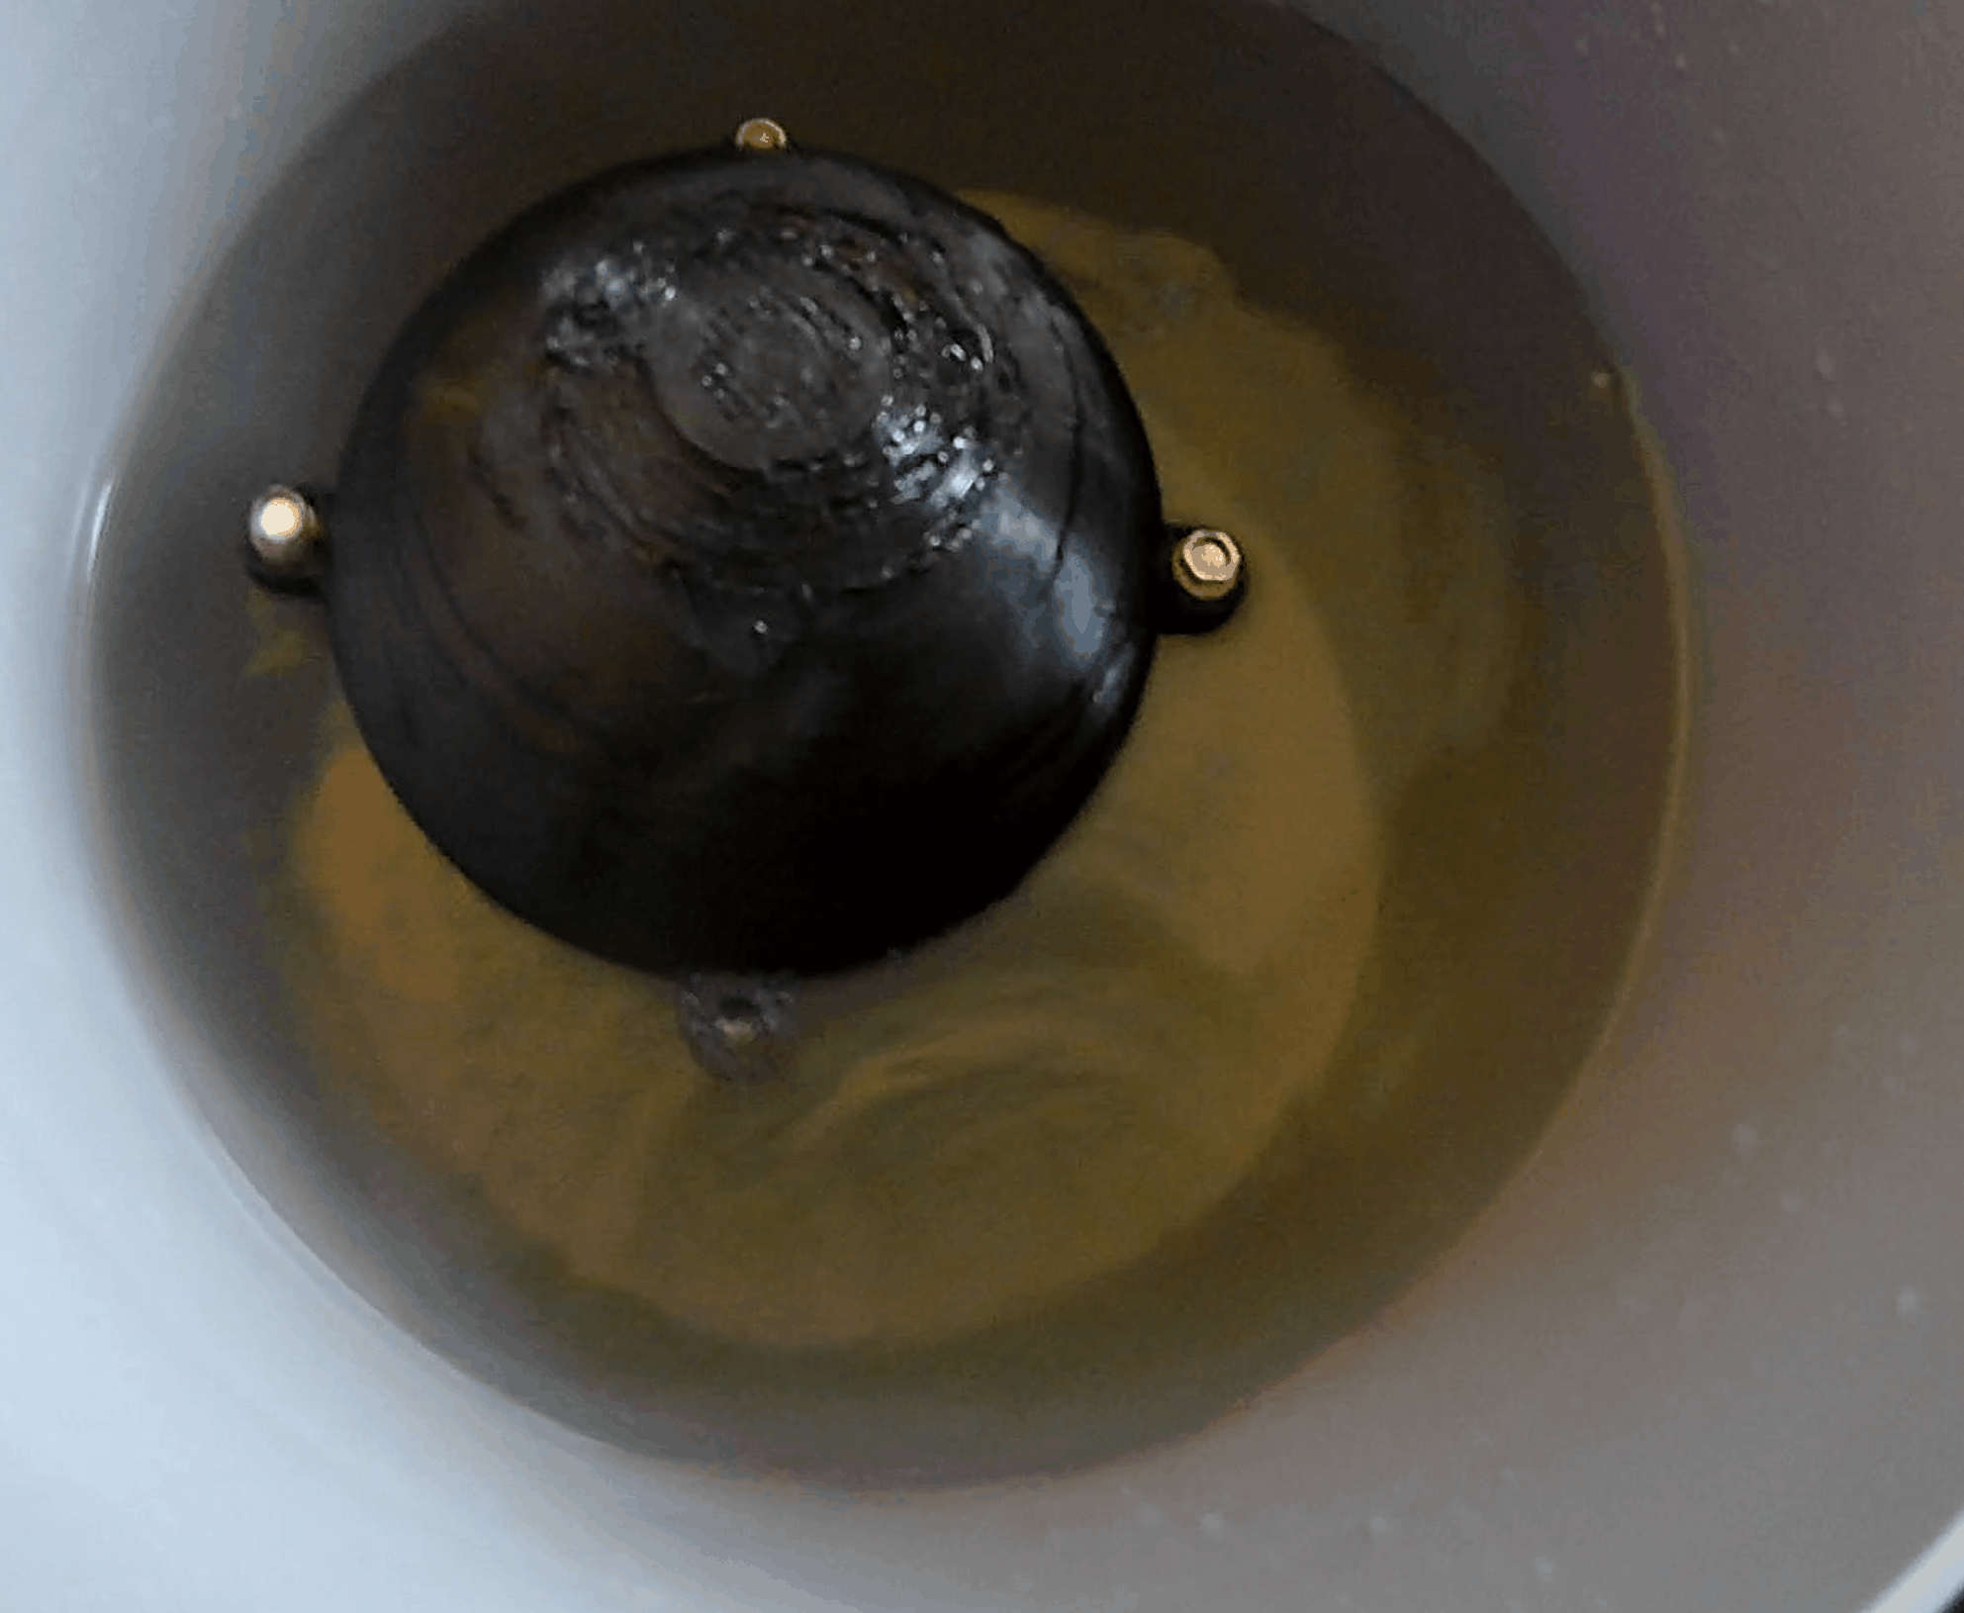
Auto righting
It is auto righting!

Slide 5
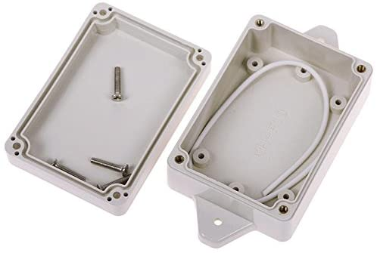
Waterproof
Mostly: only one leak
Small imperfection in base print causing leak
Higher quality prints take days
  Still not guaranteed
Waterproof Electronics box

Slide 6
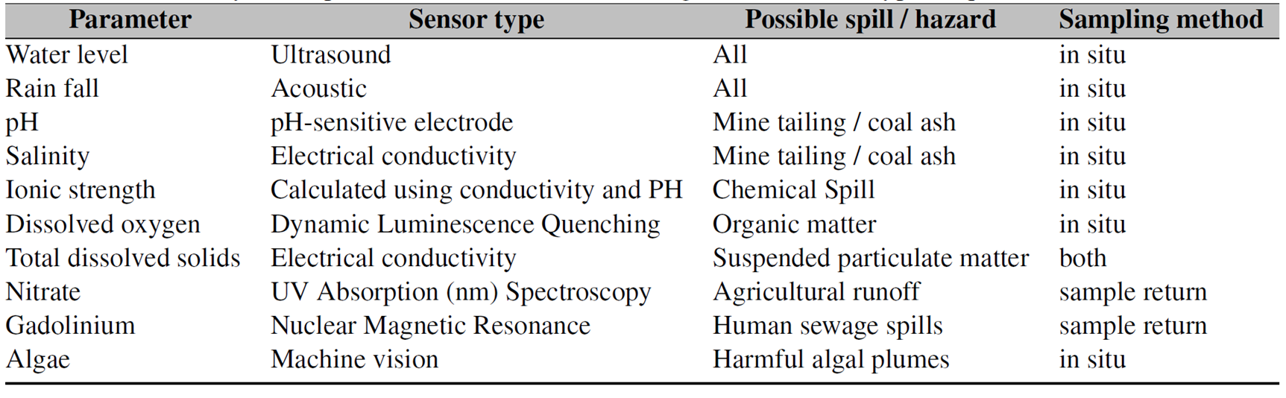
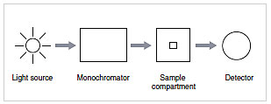
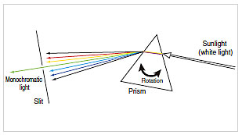
Measuring Nitrates
Chemical Test: Ring Test (iron(II) sulfate and sulfuric acid)
In Situ with UV absorption?
  Servo: to move the diffuser
  Monochromator
  Source (Sun?)
  Detector (photosensor)
Measurement range
Detect other materials in the water?
Monochromator
Angle determines the wavelength

Slide 7
Next Steps
Rainfall
  Case V1
  Regression Equation
  Mounting System
Water Probe
  Case V3
    Field testing
  Test Sensor System

Slide 8
Sources
https://pubs.rsc.org/en/content/articlelanding/2018/en/c8en00588e#!divAbstract
http://www.pitt.edu/~asher/homepage/spec_pdf/UV%20Resonance%20Raman%20Spectroscopic%20Detection%20of%20Nitrate.pdf
https://www.shimadzu.com/an/uv/support/fundamentals/monochromators.html

Slide 9
Dissolved Oxygen

Slide 10
Battery
Samsung cylinder batteries?
  Stackable
  Flexible design
  One charger for all
LiPo
Charging?
Replacing

Slide 11

Table of Parameters

Slide 12
Package Conditions
Over water
  Water Height
  Algae
In Water
  pH
  TDS
  Physical Samples
  More
Open Air
  Rainfall
  Other?

Slide 13
3 packages
Above water package
  Currently the water height sensor package
  Add camera for algae machine vision detection capabilities
In water package
  Under development
Open air package
  Testing/development

Slide 14
Probe Swap
Easier
Eliminates Docking

Slide 15
Measuring Nitrates
Chemical Test: Ring Test (iron(II) sulfate and sulfuric acid)
In Situ with UV absorption?
  Servo: to move the diffuser
  Monochromator
  Source (Sun?)
  Detector (photosensor)
Measurement range
Detect other materials in the water?
Monochromator
Angle determines the wavelength

Slide 16
Nitrates
Determination of Nitrate in Water Containing Dissolved Organic Carbon by Ultraviolet Spectroscopy
200-205 nm & 300 nm
2 wavelengths avoid organic intereference

Slide 17
Dissolved oxygen
Rapid and precise determination of dissolved oxygen by spectrophotometry: Evaluation of interference from color and turbidity
430nm
Low organic interference

Slide 18
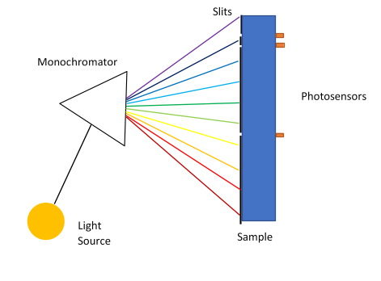
Uv absorption
Sample return
  Easiest
Fixed wavelengths
  Nitrates only
Spectrum
  Moving parts
  accuracy
  Slit size precision

Slide 19
Battery
Samsung cylinder batteries?
  Stackable
  Flexible design
  One charger for all
LiPo
Charging?
Replacing

Slide 20
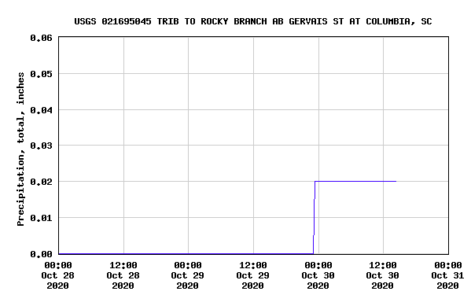
Data
USGS only registered 0.02 in rainfall event
USGS records rainfall for every quarter hour
Very windy
Increase sample size decrease the sample rate

Slide 21
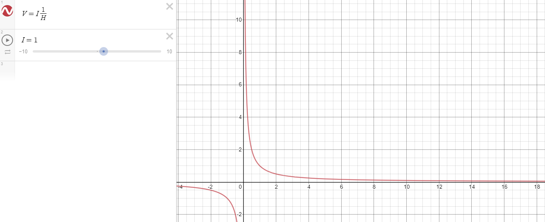
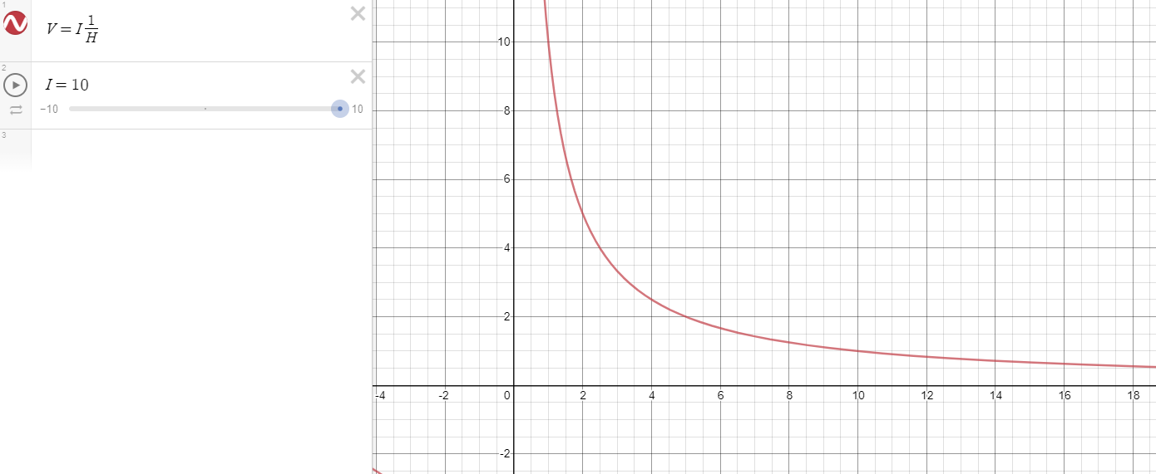
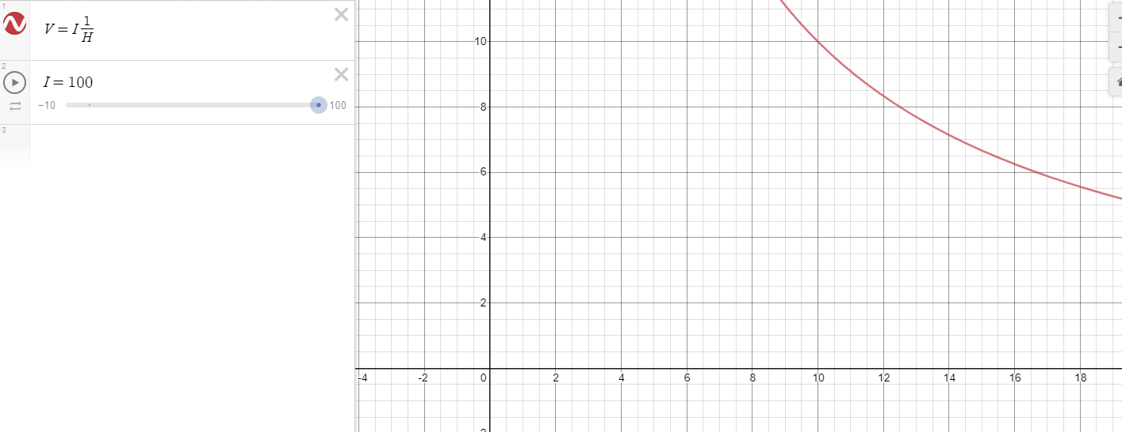
Redesign top piece
Deformation internal electrode holder
  Due to heat
  Make thicker and connect
Reciprocal Function
  V=IR = I*(1/H)
  Flatten the curve
    Increase the current
    Angle the electrodes?

Slide 22
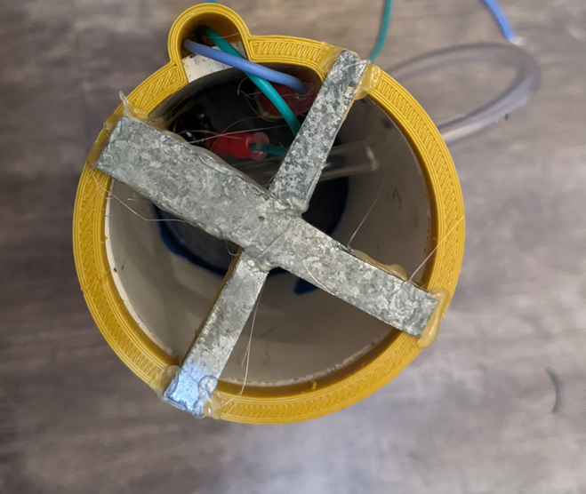
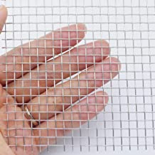
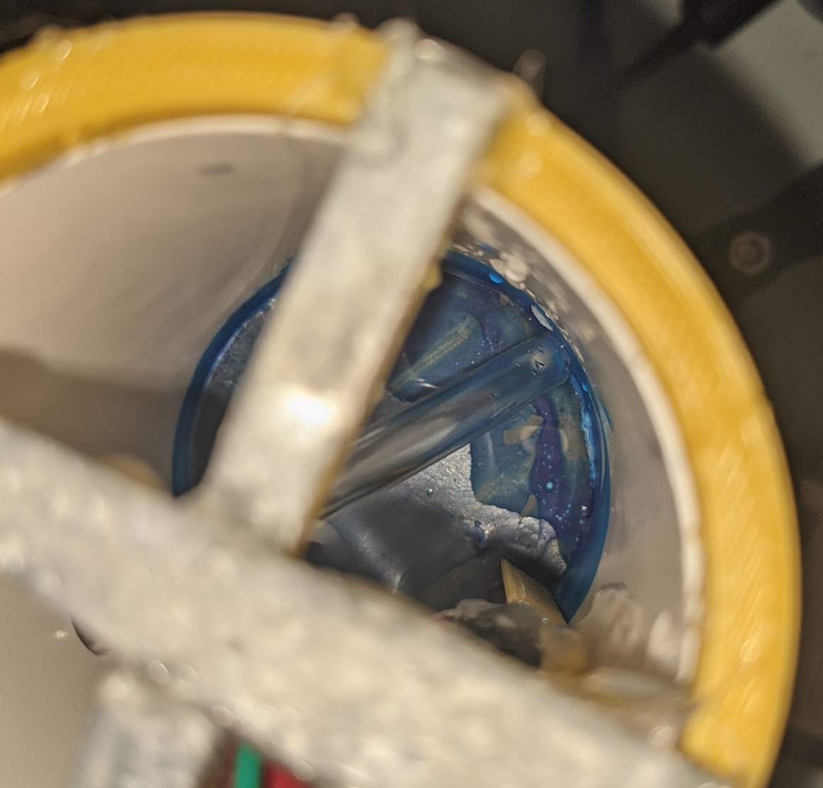
New top
Issues
  Want resolution
  Want a better capture ratio
    Disrupted due to wind and drone docking port
Funnel intake
  Increase SA?
    Better for wind events
  Reduced Height?
Magnetic mount area
  Ferrous steel
  400 grade SS
  Mesh

Slide 23
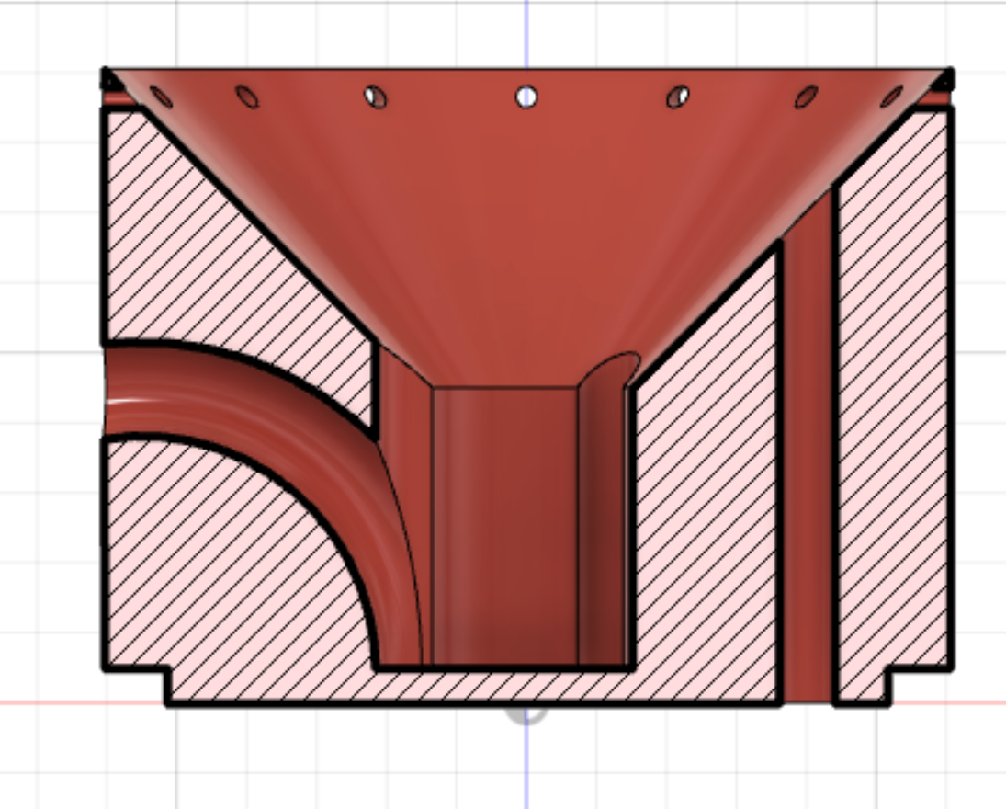
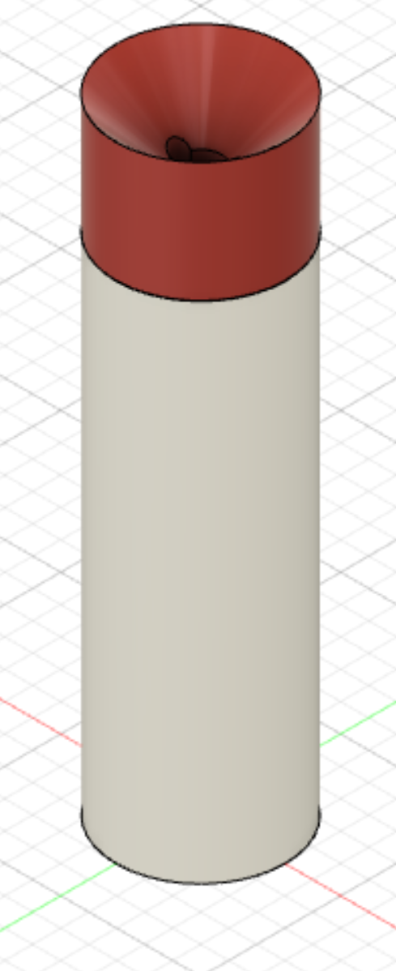
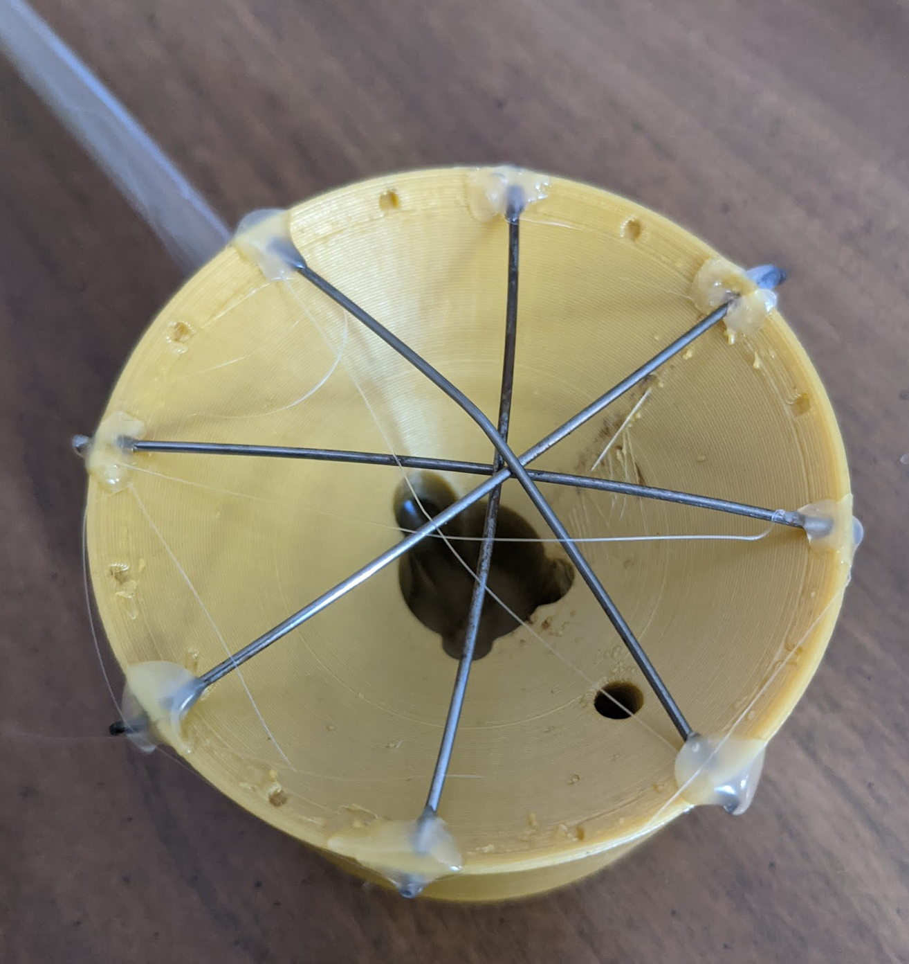
New top
Reduced overall height (reduction of 40mm)
Easier assembly
Internal wiring
More accurate data (ratio of ~16:1)

Slide 24
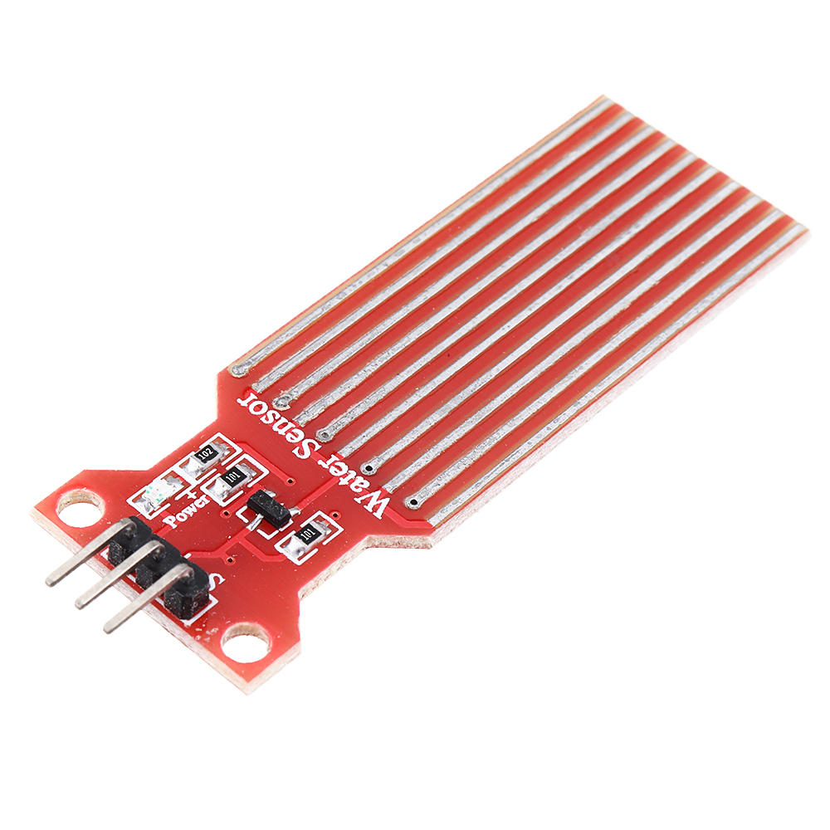
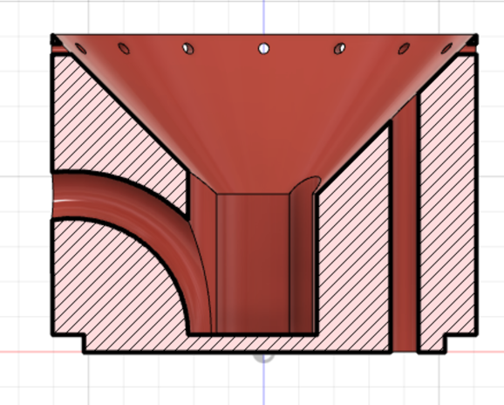
Capacitance
Starting capacitance of 11.2768 pF (for rainfall of 0.01 in at a separation of 1mm)*
Issue: Arduino can measure down to 100 nF*
How to fix the issue
  Different circuit?
  Increase intake ratio
  Change to PCB sensor (coat with a material)

Slide 25
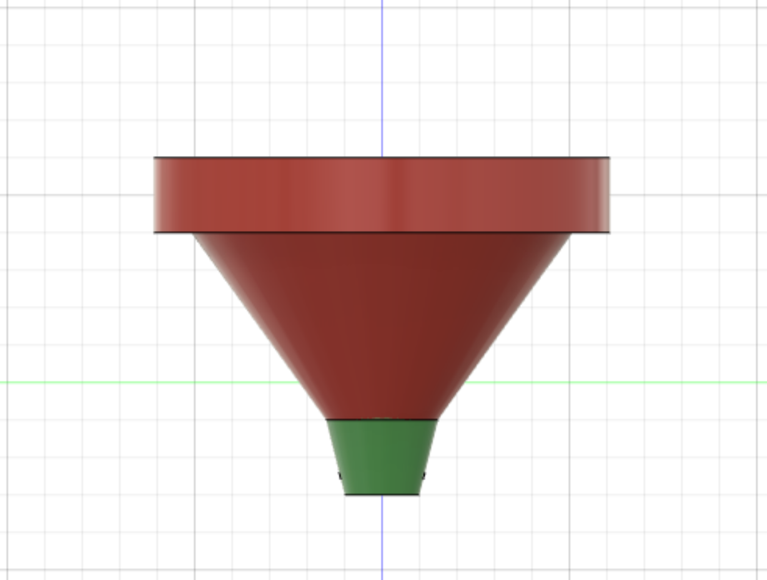
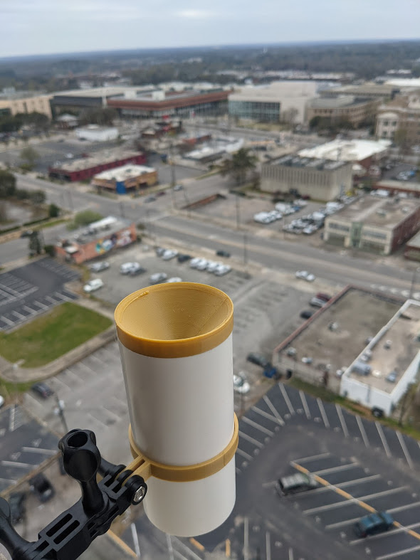
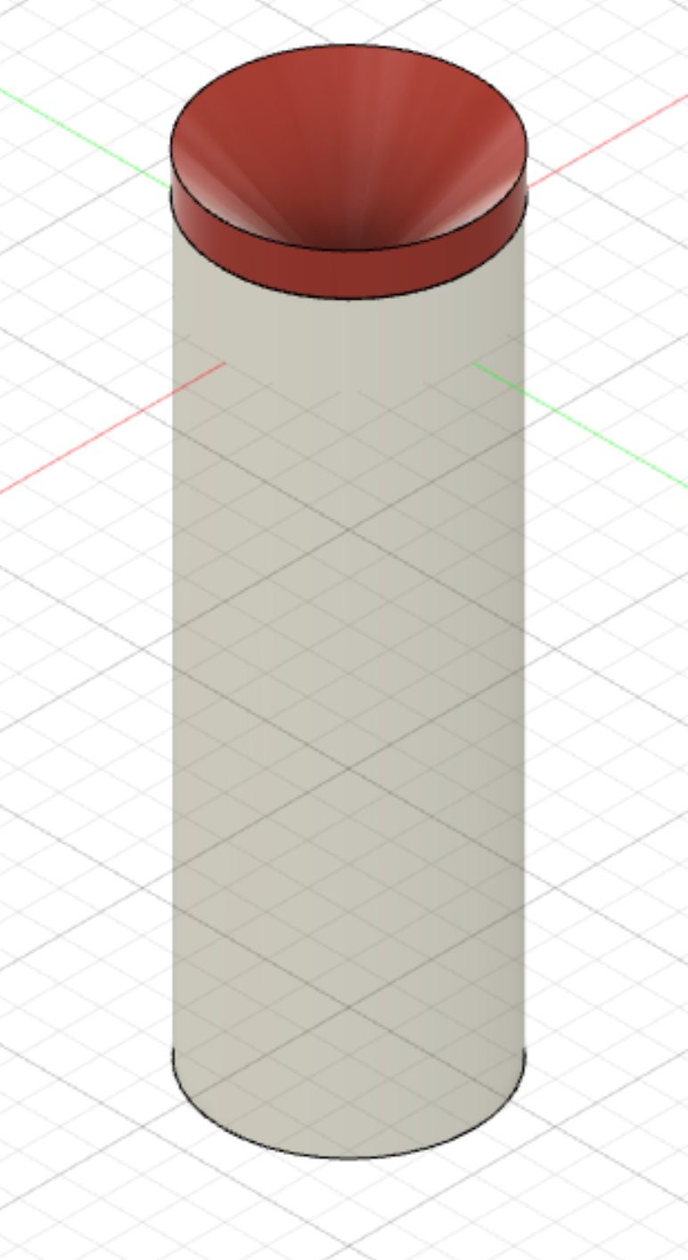
Rainfall sensor
Funnel
Internal Nozzle
No moving parts
High accuracy: drop counting
Counts individual drops per area
Converted to inches/hour
Water drains out the bottom
Electrodes

